Slide 1
Connected Device Studio Skill Transfer Workshop
Kevin Kao | Walker Lin | Andy Li
Microsoft IoT Innovation Center

Slide 2
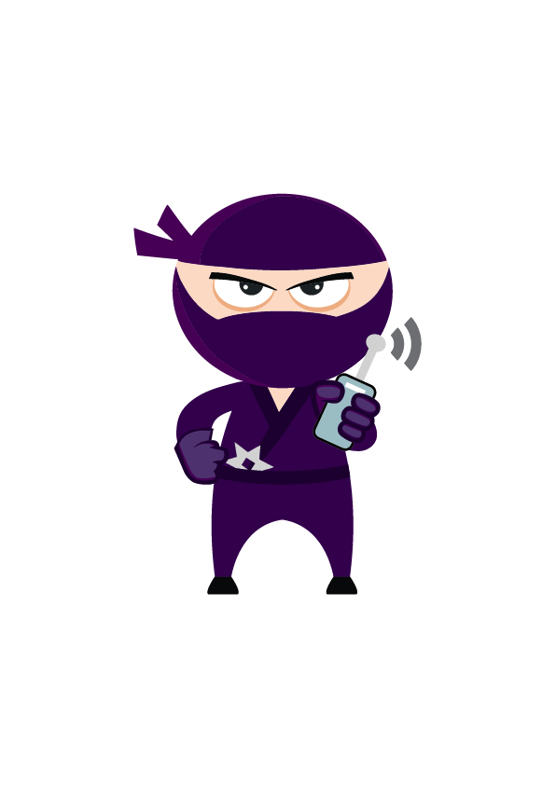
Content
Section 1 (4 hours)
Deploy Azure Services
Deploy DB and Data
Deploy API Service, Admin and SuperAdmin
Deploy Backend Tasks
First Company Onboarding
Remote Monitoring
Section 2 (4 ~6 hours)
DB Schema Overview
API Service (EF, Authentication and Class Model)
Admin & SuperAdmin (MVC and Call Flow)
Toolkit Device SDK & IoT Hub Receiver
Signal R & Message
Section 3 (4 hours)
Service Bus & OpsInfra, OpsAlarm, RoutineTask
Document DB
Service Fabric
Log & Operation and Trouble Shooting
Section 4 (4 hours)
How to Add New API
How to Add New Widget
How to Setup Staging Env

Slide 3
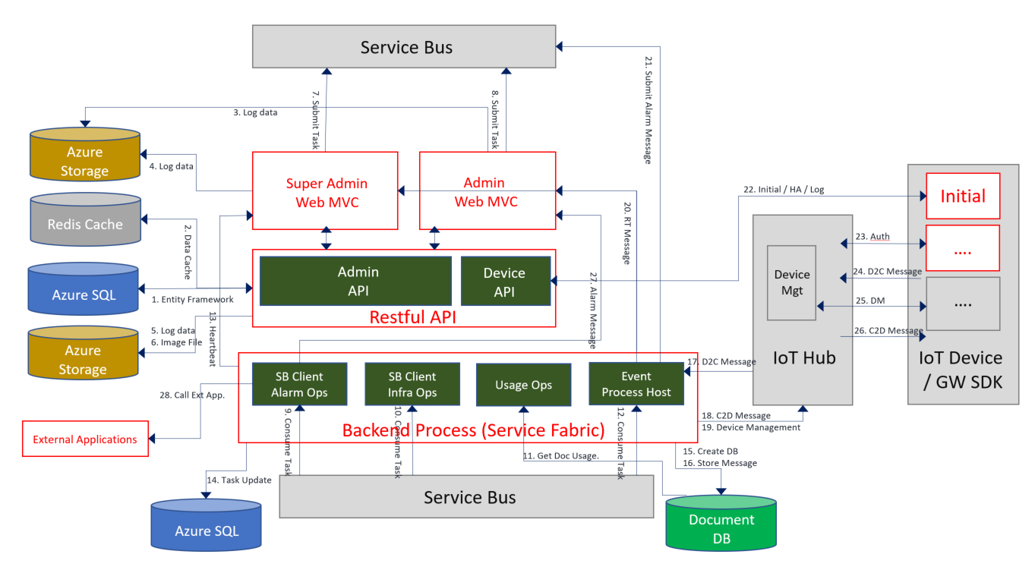
Architecture

Slide 4




AdminWeb Environment Diagram
Blob Storage: Store log data.
Service Bus: Send backend task request, such as Launch/Restart IoT Hub Receiver and Register IoT Device to IoT Hub.
Redis Cache:
Store WebApp Session State
SignalR Hub data repository
API Service: CRUD operations
Blob Storage
API Service
Admin Web
Service Bus
Redis Cache

Slide 5
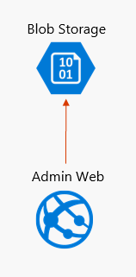
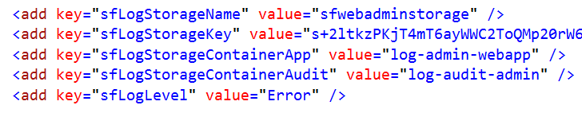
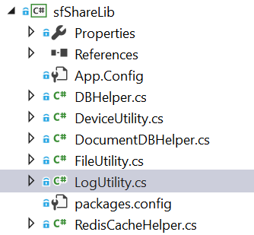
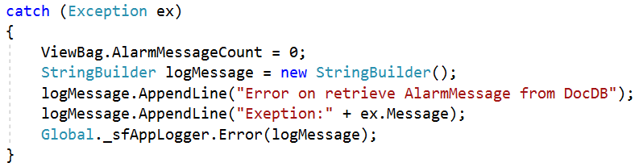
Blob Storage
Web.config
Implementation
C# Code

Slide 6
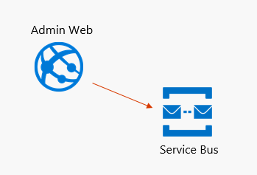
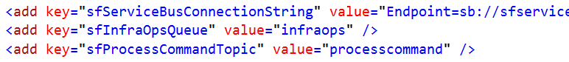
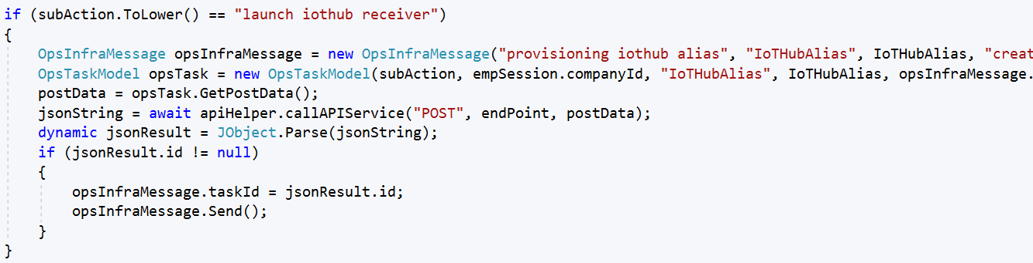
Service Bus: Launch IoT Hub by Message Queue
Web.config
C# Code (MonitorController.cs)

Slide 7
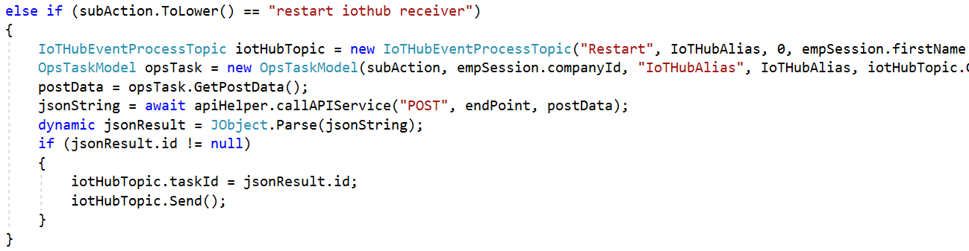
Service Bus: Restart IoT Hub by Topic
Web.config
C# Code (MonitorController.cs)

Slide 8
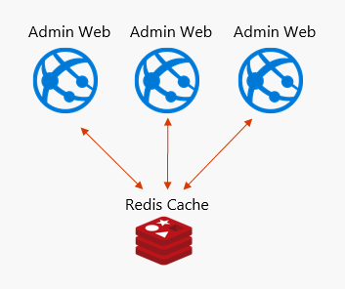
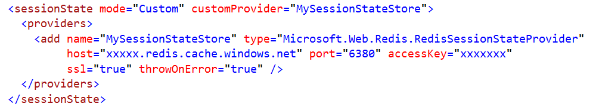
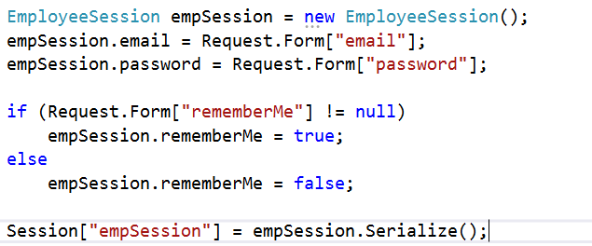
Redis Cache: WebApp Session State
Web.config
We Store 3 Objects to reduce Redis Cache Access (Models)
public class CompanySession
public class EmployeeSession
public class LoginMsgSession

Slide 9
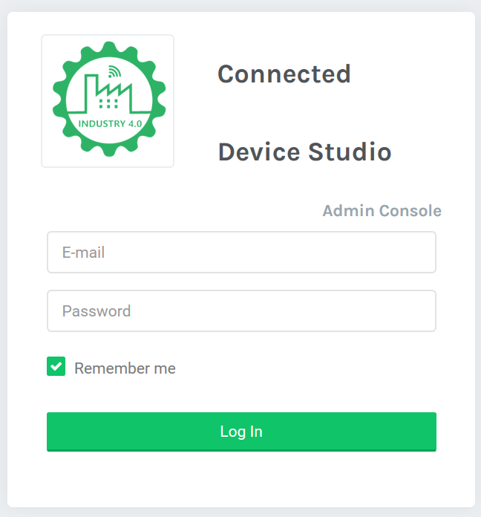
AdminWeb Login Process
GetAuthenticationToken
Catch Exception
/Home/DoLogin
Get empSession
Read Email and PW
Redirect To
Call API Service
( deviceType EP )
Yes
Is Null (Email/PW)?
/Home/Index
Get Redirection Path
No
Store empSession
Redirect To
GetAuthenticationToken

Slide 10
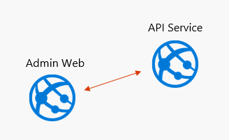
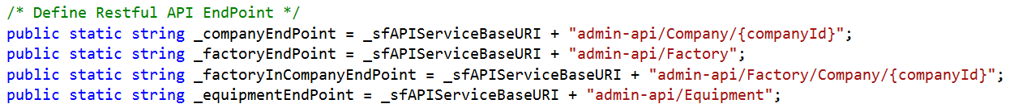
API Service
Web.config
Global.asax
Controller

Slide 11
apiHelper.callAPIService Flow
Constructer
callAPIService
Catch Exception
Replace {companyId}
empSession?
No
Throw Exception
No
Throw Exception
Unauthorized?
Assign AuthToken
Yes
Yes
getAPIToken
Store empSession
Call EndPoint
Complete?
No
Throw Exception
Exit
Read Response
Yes
Return Response
callAPIService

Slide 12
API Service Access Token
Caller doesn’t deal with API Token
API Token stored at EmployeeSession, and only.
We don’t care when API Token get expired.
apiHelper offers below methods as well

Slide 13
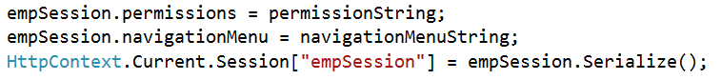
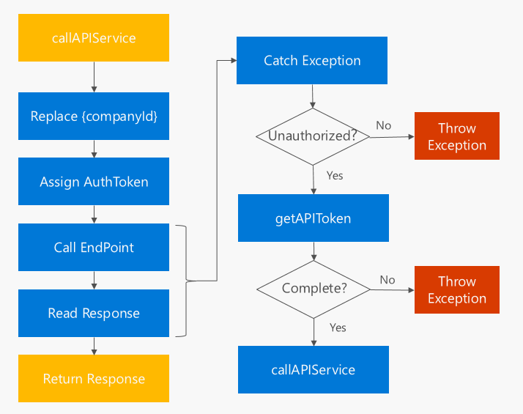
Navigation & Permissions
Models/RestfulAPIHelper.cs
Call API: /token
Get API Response
Initial Permissions
OK?
Store Permissions & Navigation at Session
Yes
After Login Initial
Call API: /Permissions

Slide 14
Navigation & Permissions
10,20,30,40,41,42
<li id="menuFactory"><a href=/Factory/Index><i class="zmdi zmdi-windows"></i> <span> [[[Factory]]] </span> </a></li>
<li id="menuEquipment"><a href="/Equipment/Index"><i class="ti-harddrives"></i> <span> [[[Equipment]]] </span> </a></li>
<li class="has-submenu" id="menuIoTDevice"><a href="#"><i class="ti-signal"></i><span> [[[IoT Device]]] </span> </a>
<ul class="submenu">
<li><a href="/IoTDevice/Index">[[[IoT Devices]]]</a></li>
<li><a href="/IoTDevice/MessageAttach">[[[Device Message]]]</a></li>
<li><a href="/IoTDevice/ConfigurationManagement">[[[Device Configuration]]]</a></li>
</ul>
</li>

Slide 15
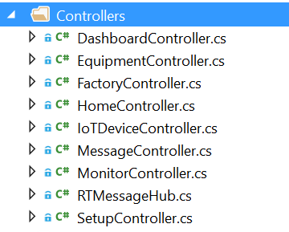
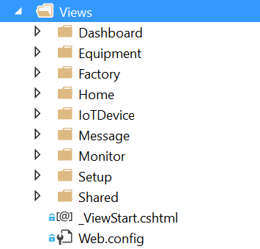
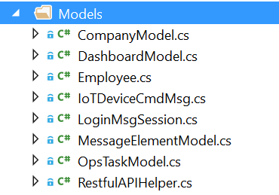
AdminWeb Design and Call Flow
MVC Design Pattern
Controller
View
Model

Slide 16
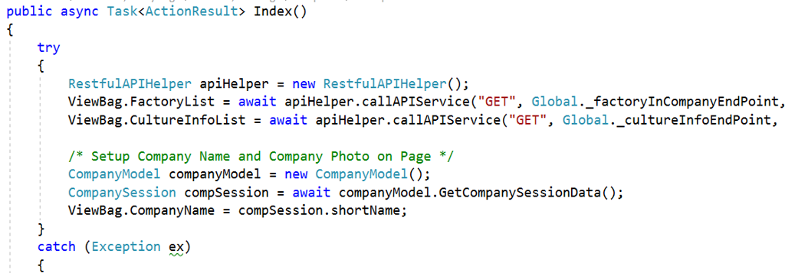
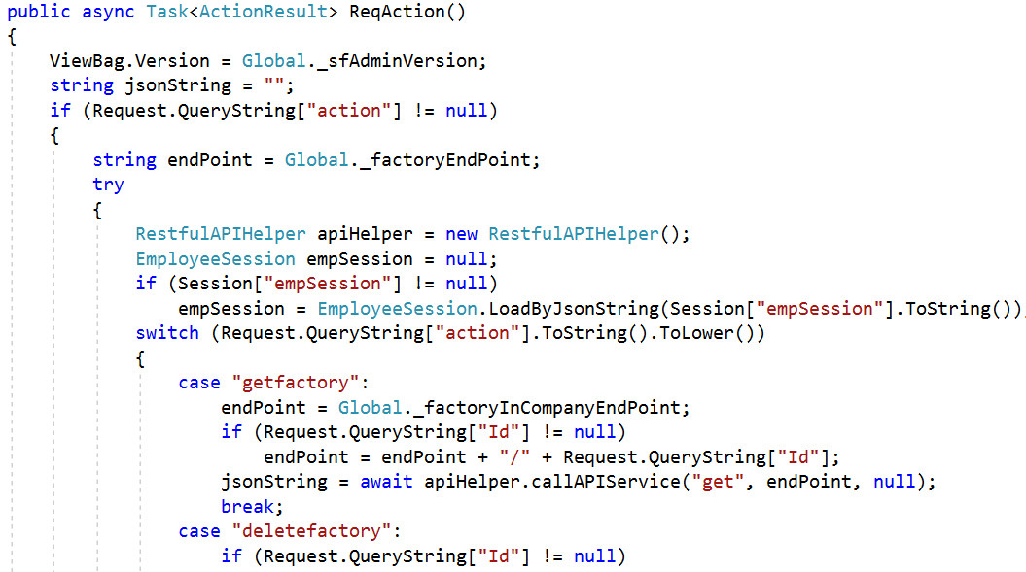
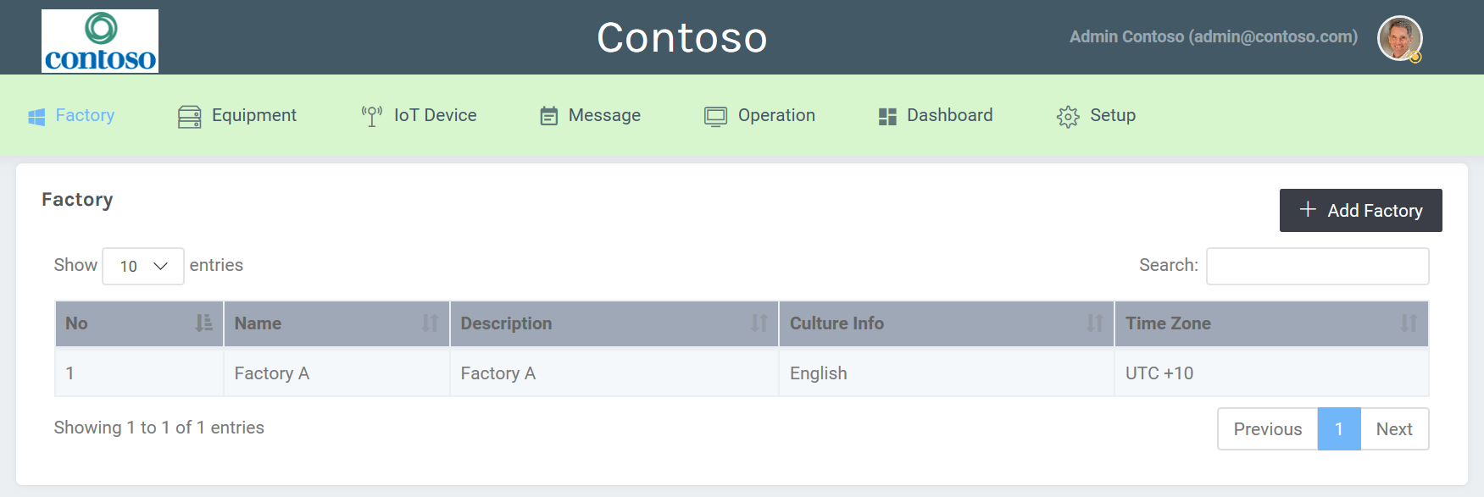
AdminWeb Design and Call Flow
Controllers/FactoryController.cs
Views/Factory/index.cshtml
HTML + CSS + JS + @ViewBag
AJAX

Slide 17
SuperAdmin Environment Diagram
Almost same with Admin Web
No Redis Cache
Blob Storage
API Service
SuperAdmin
Web
Service Bus

Slide 18
Section 2 Admin & SuperAdmin End
Kevin Kao | Walker Lin | Andy Li
Microsoft IoT Innovation Center

